Slide 1
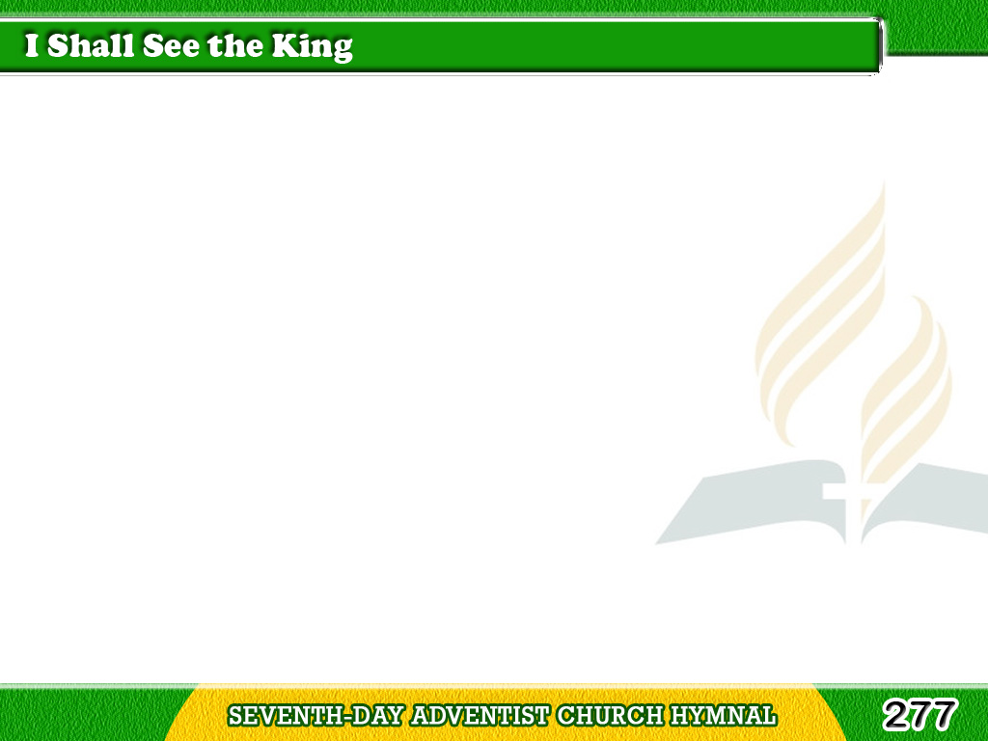
1/3
I shall see the King
Where the angels sing,
I shall see
the King some day,
Tagalog
Version

Slide 2
1/3
In the better land,
On the golden strand,
And with Him
shall ever stay.
Tagalog
Version

Slide 3
1/3
Chorus
In His glory,
I shall see the King,
And forever
endless praises sing;
Tagalog
Version

Slide 4
1/3
Chorus
‘Twas on Calvary
Jesus died for me;
I shall see the King
someday.
Tagalog
Version

Slide 5
2/3
In the land of song,
In the glory throng,
Where they never
comes a night,
Tagalog
Version

Slide 6
2/3
With my Lord once slain
I shall ever reign
In the glory land of light.
Tagalog
Version

Slide 7
2/3
Chorus
In His glory,
I shall see the King,
And forever
endless praises sing;
Tagalog
Version

Slide 8
2/3
Chorus
‘Twas on Calvary Jesus
died for me;
I shall see the King someday.
Tagalog
Version

Slide 9
3/3
I shall see the King,
All my tributes bring,
And shall look upon His face;
Tagalog
Version

Slide 10
3/3
Then my song shall be
How He ransomed me
And has kept me by His grace.
Tagalog
Version

Slide 11
3/3
Chorus
In His glory,
I shall see the King,
And forever
endless praises sing;
Tagalog
Version

Slide 12
3/3
Chorus
‘Twas on Calvary Jesus
died for me;
I shall see the King someday.
Tagalog
Version

